Slide 1
Project Proposal:
Quantum Image Recognition
By Julian Blanco, Diego Vazquez

Slide 2
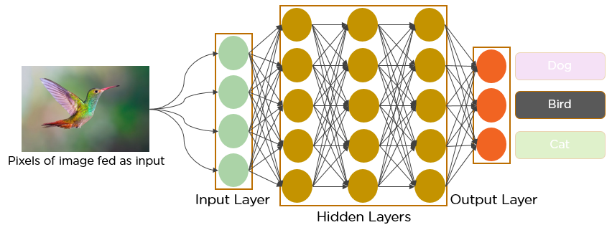
Classical Image Recognition
Feeds pixel data into model
Model comprised of Convolutional layers and fully connected
Convolutional layers finds similarities in pixel data
Connected uses pixel data to make guesses

Slide 3
Hybrid Quantum Neural Network (HQNN)
Combine classical & deep learning architectures with QML algorithms
PQC
Process large datasets
Shown promise in healthcare, finance, chemical, & aerospace

Slide 4
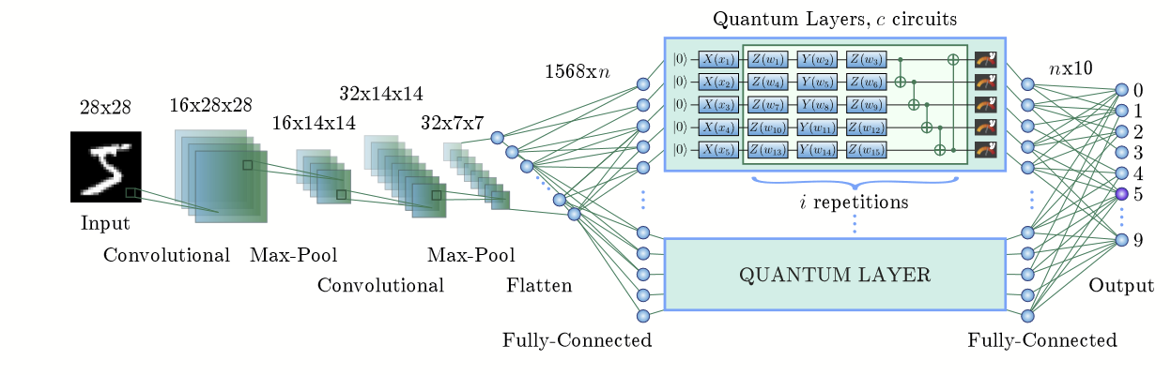
HQNN-Parallel
Classical classification, quantum fully connected
Quantum filters into classical dense layers
Quantum layers composed of Parameterized Quantum Circuits
3 main parts: Embedding, variational gates, and measurement

Slide 5
Embedding
n features from previous fully connected layer, divided into c parts, with each part being a vector of q values
Rotate qubit around X-axis
Encodes the input vector into quantum space
2
resulting quantum state represents the input data

Slide 6
Variational Gates
Rotations with trainable parameters and subsequent CNOT operations
Transform data according to parameters
CNOT entangle qubits

Slide 7
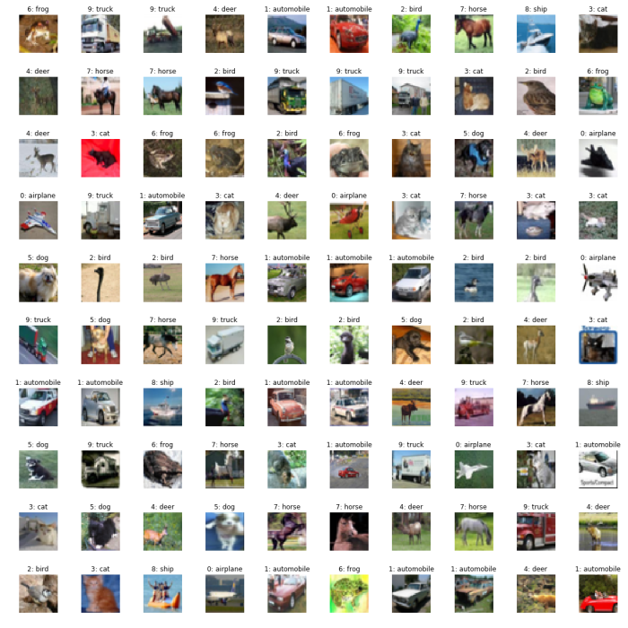
Plan
– Create classical model
– Create HQNN-Parallel
– Train models on CIFAR 100 dataset
– Improve accuracy based on training results
– Compare accuracy, speed and total parameters

Slide 8
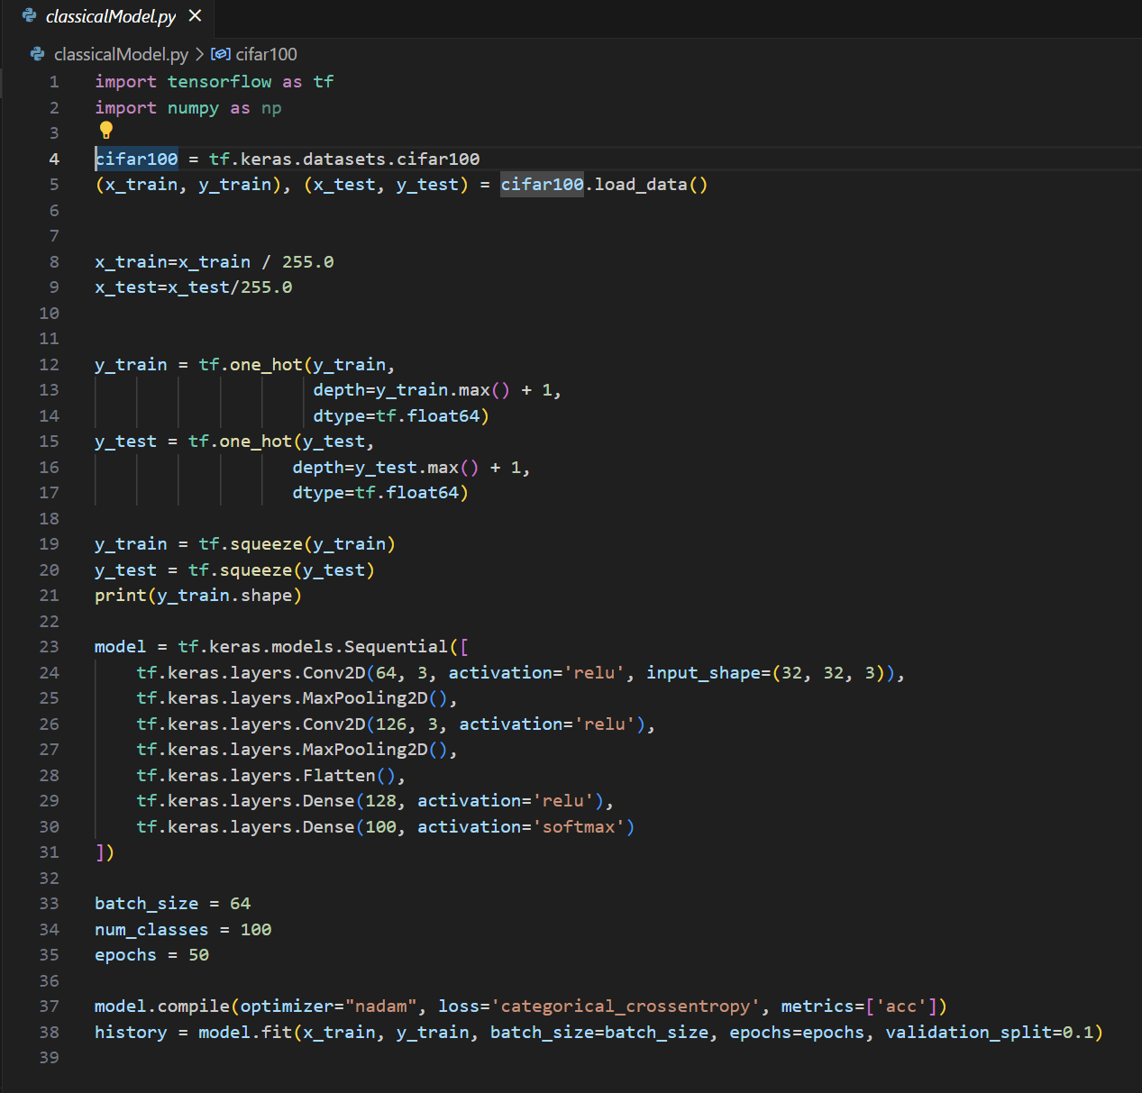
Classical Method
Used tensorflow to build classical machine learning model
Trained to reach accuracy of about 95% on CIFAR 100 dataset
In the model, we want to implement our own quantum keras layer right after the flatten layer

Slide 9
References
https://arxiv.org/pdf/2304.09224

